Slide 1
Thomas Johann Seebeck Department Of Electronics
Tallinn University of Technology, Estonia
Smart Infrastructure
Smart traffic sign
Harish Kumar Singh
MSc in Communicative Electronics (2017-19)
Project Supervisor - Senior Research Scientist Mr.Andri Riid
Internship Supervisor - Dr. Alar Kuusik

Slide 2
Index
Problem Statement
Hardware
Software
IS16 Lidar
Lidar Initial Test Response
IMX377M12 Camera
Camera Initial Test Result
End Solution

Slide 3
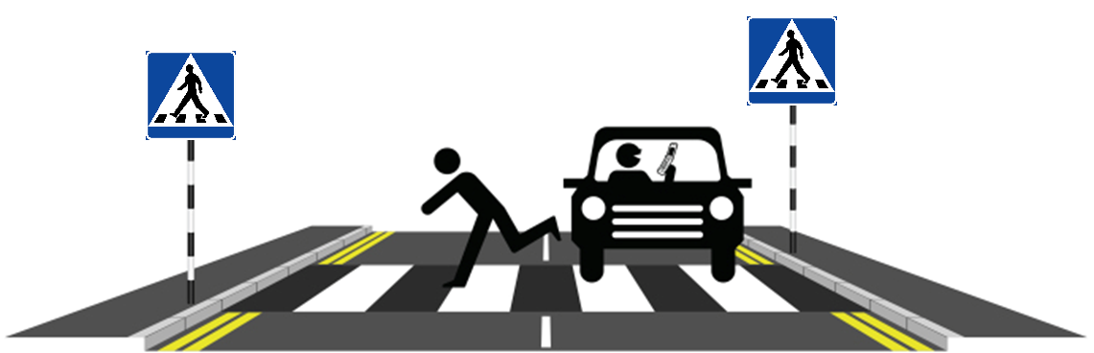
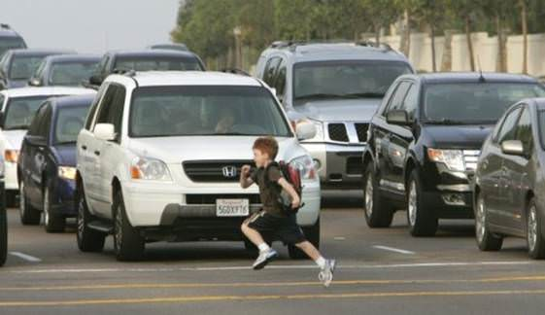
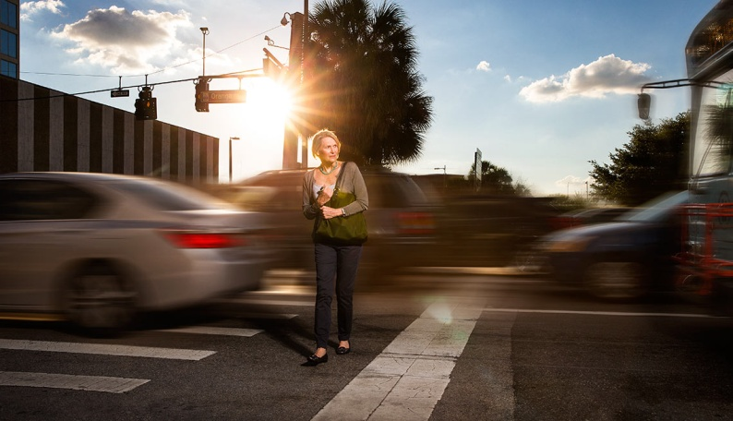
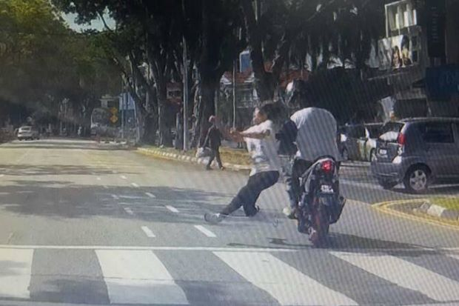
Problem Statement

Slide 4
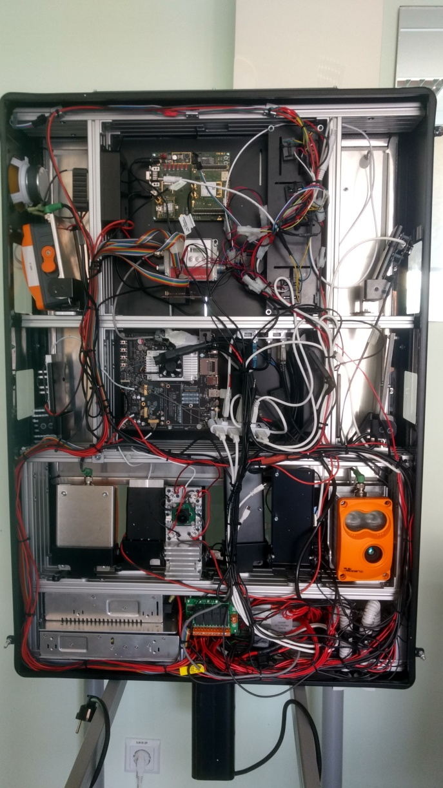
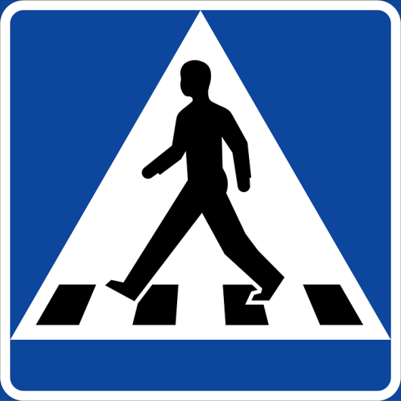
Hardware
NVIDIA Jetson TX2
Lidar
Cameras
Radar
LEDs

Slide 5
Software
Programming in C, C++ and Python
OpenCV
SQLite
H2 Database
JSON format data
Yolo image recognition library

Slide 6
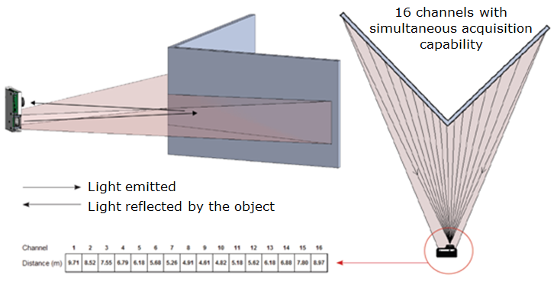
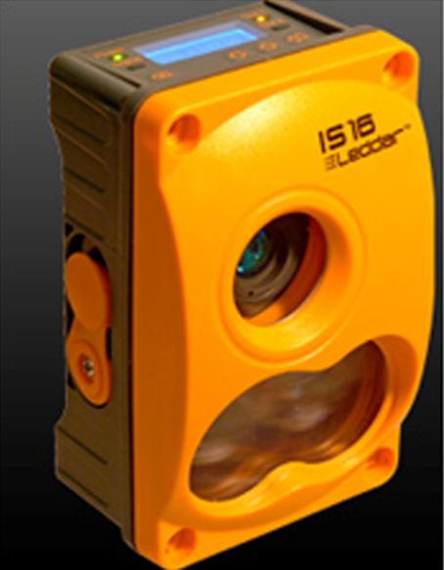
IS16 Lidar
0 to 50 m detection
Rapid measurement
rate – up to 50 Hz
16 detection segments
Beam width 45°, height 7.5°
RS-485 or CAN bus
Up to 3 detection per segments

Slide 7
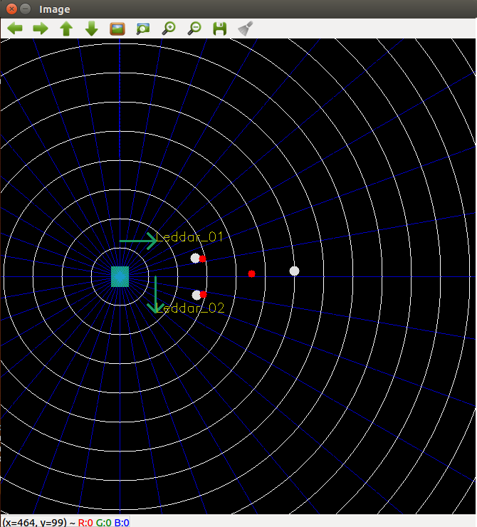
Lidar Initial Test Response

Slide 8
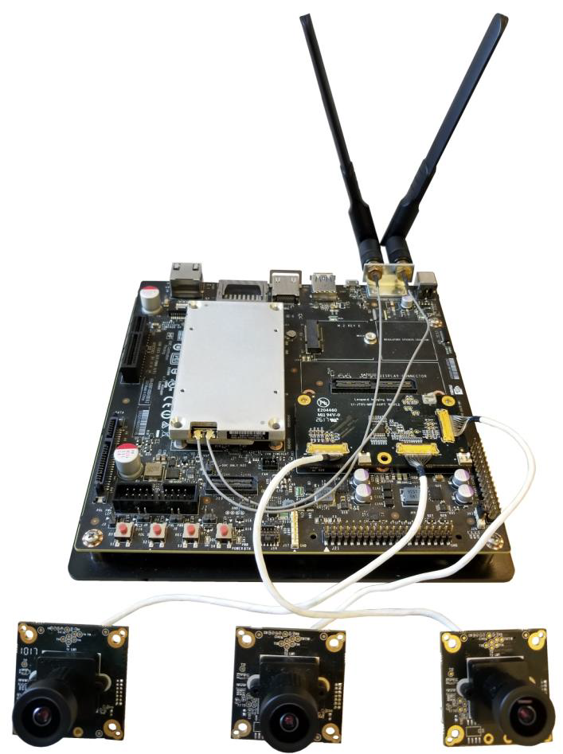
IMX377M12 Camera
Support 13M@30fps
Color camera
Built in 650nm IR
cut filter
FOV (H/V): 86° /69°
TV Distortion: -1.0 %

Slide 9
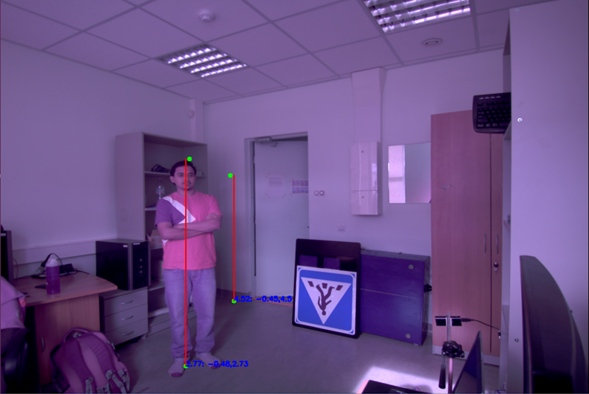
Camera Initial Test Result

Slide 10
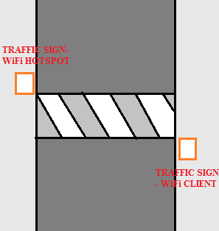
End Solution
Analysis vehicle and pedestrian actives to predict possibility of accidents.
Traffic signs on the both side
of road will interact to each
other over WiFi to keep
notifications in sync.

Slide 11
Thanks for your time!!
Let me know if you want similar solutions.

